Slide 1
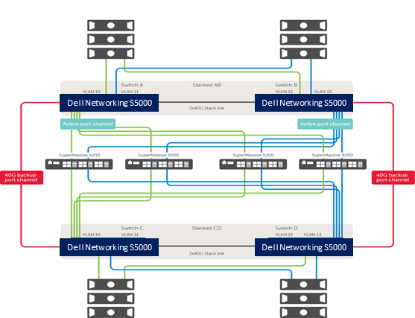
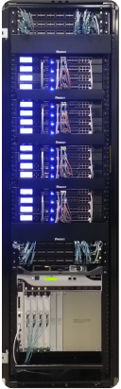

120 G+ DPI and beyond
Aravind Thangavelu
Executive Director, Software Engineering

Slide 2




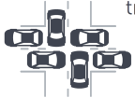
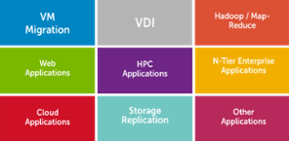
Unavoidable realities
Threats are increasing in scope and sophistication
Malware are deeply hidden beneath the surface
More devices
means more risk
!
More applications means more vulnerabilities
Bandwidth needs continue to grow
Increasing east-west
traffic enlarges attack surface

Slide 3
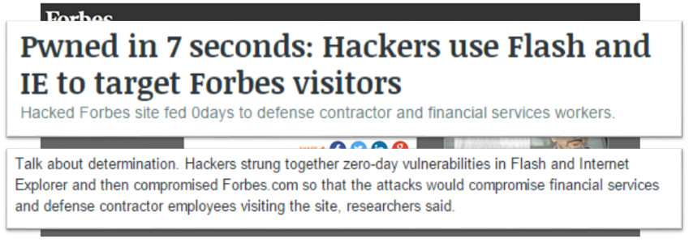
Problem of software vulnerabilities and malware continue for customers

Slide 4
Next Gen Firewalls: Security through Deep Packet Inspection
Stateful Packet Inspection
Stateful packet inspection
Intrusion prevention
Threat prevention (anti-virus/spyware)
SSL decryption
Application identification & visualization
Application control
User identification through Single Sign On (SSO)
Deep Packet Inspection

Slide 5
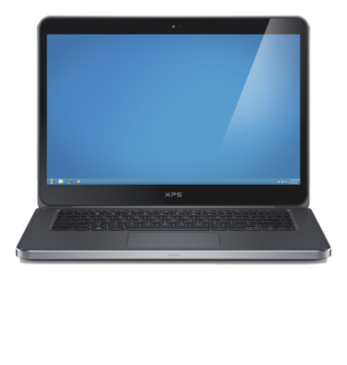






Next Generation Firewall (NGFW)
Breaks the malware cycle
URL Filtering
Compromised “Good” Site
Page Visit
Intrusion Prevention
Exploit
SSL Decryption
Network Anti-Virus
Cloud Anti-Virus
Botnet Filtering
Malware Hosting Site
Malware Request
Protect the Endpoints
Malware
Notes:
DMITRIY

Slide 6
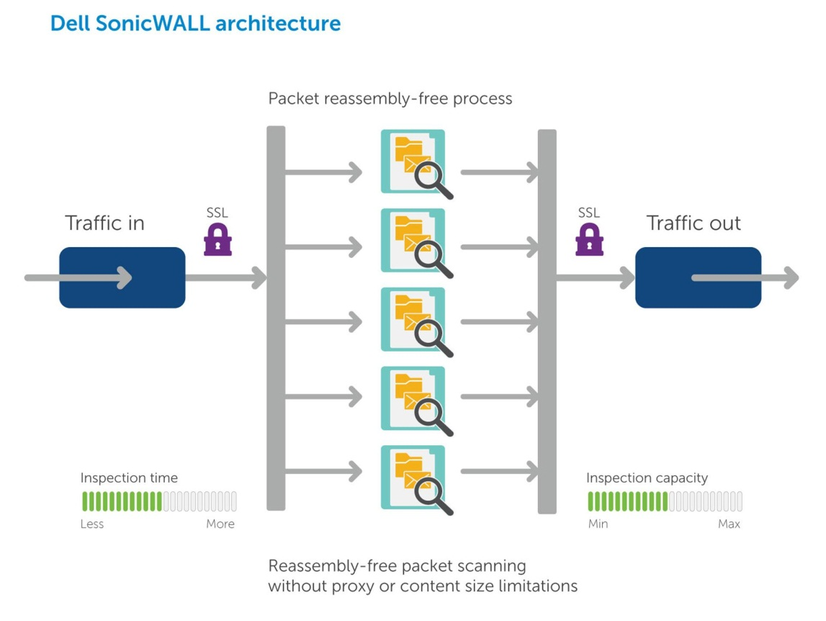
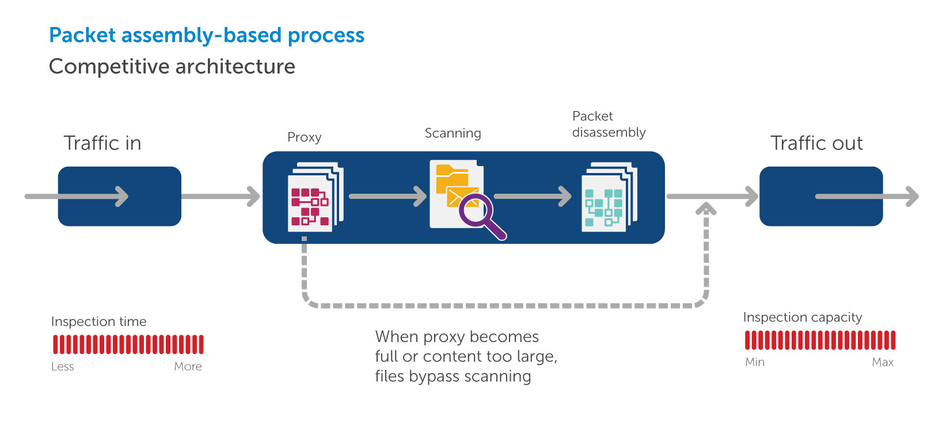
Reassembly-Free Deep Packet Inspection® (RFDPI) versus Packet assembly-based architecture
Malware
U.S. Patents 7,310,815; 7,600,257; 7,738,380; 7,835,361

Slide 7
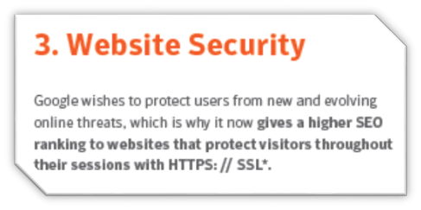
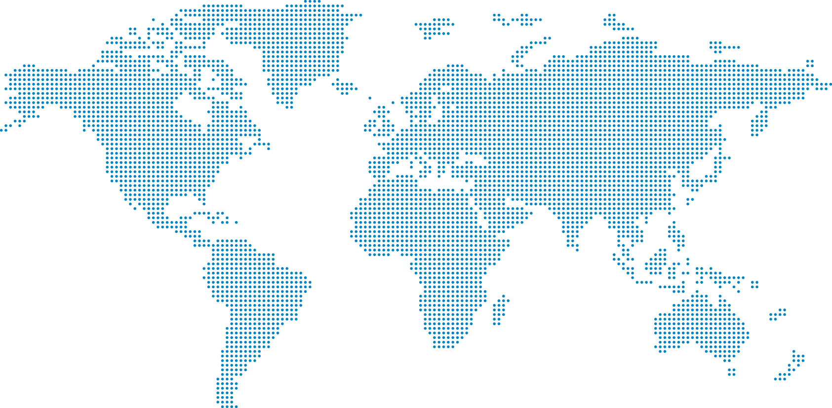
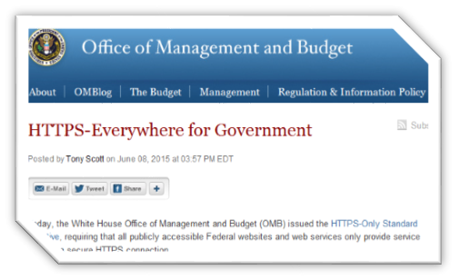
Encrypted web traffic growth
SSL/TLS comprises 15–20 percent of total web traffic and 25–35 percent of typical enterprise traffic
There’s an average yearly increase of 20 percent in SSL/TLS traffic
Only 20 percent of enterprises with next-generation firewalls (NGFWs) inspect inbound/outbound SSL/TLS traffic
50 percent of all inbound/outbound attacks will use SSL/TLS by 2017
          - Gartner
58%
315%
470%
Notes:
Snowden effect, the growth in encrypted web traffic in 2014 by regions

Slide 8
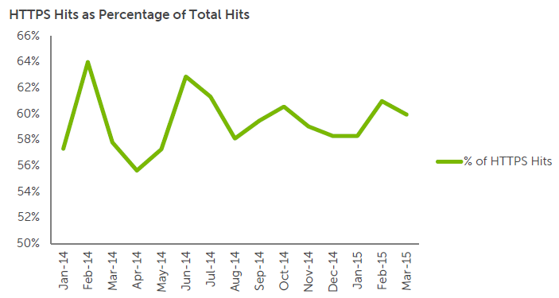
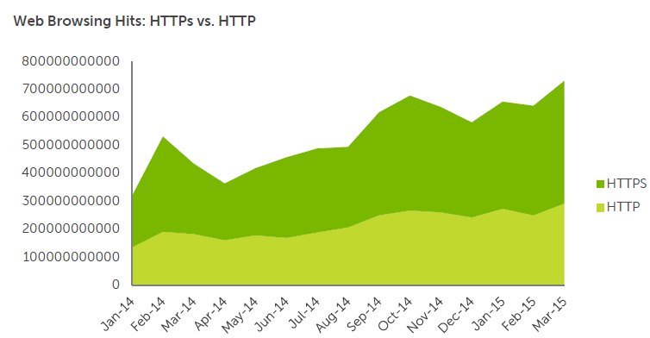
You can’t protect what you can’t see — hackers are hiding in plain sight (SSL/TLS encrypted traffic)
Dell saw HTTPS web connections grow 109 percent in CY2014
Example: Yahoo (SSL encrypted HTTPS sessions) third-party banner ads distributed malware over four days (27,000 users per hour) — an attack unseen by most firewalls

Slide 9
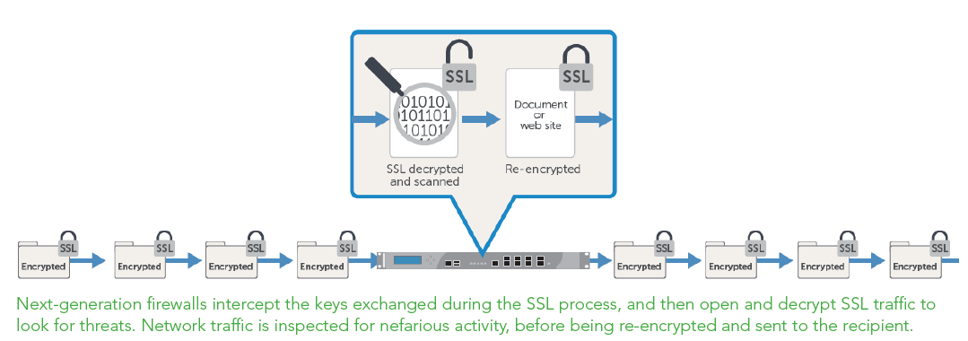
Organizations need next-generation protection to eliminate blind spots in SSL traffic — how much of your network traffic is HTTPS?
How can we add and scale this critical protection to prevent lag and network latency?

Slide 10
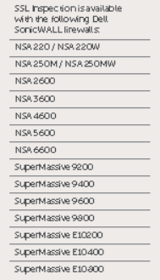
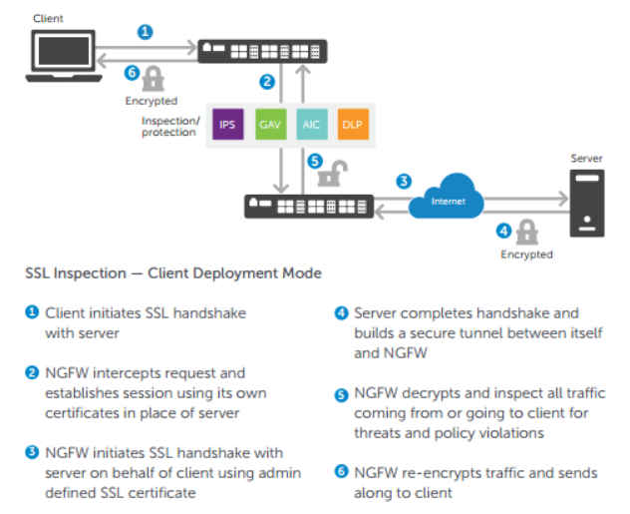
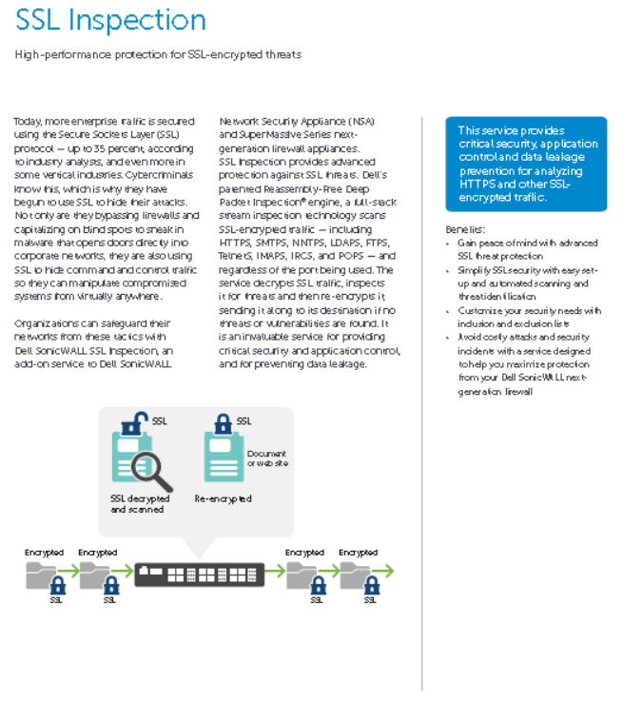
SSL Inspection is easy to understand and available across the entire portfolio too…

Slide 11
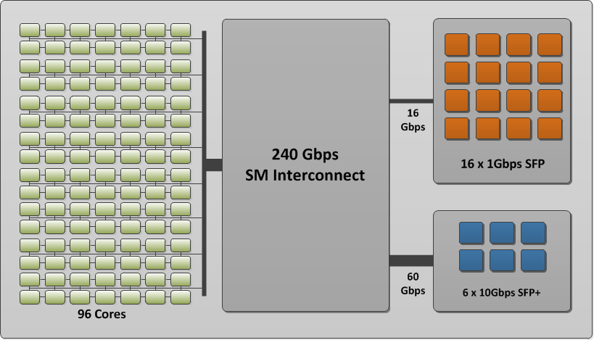
Ultra multi-core design for high performance networks
High Performance Massively Multicore Design
Up to 96 Processor Cores / 77Ghz
240 Gbps Interconnect
Ultra-Low Latency

Slide 12
What is a Firewall Sandwich (FWS)?
“A scale-out, highly resilient Layer 2 and 3 architecture providing transparent and or NATed/Routed security services to enhance existing security solutions”
DOES:
  Can replace traditional HA firewall architectures
  Work with Dell Networking S4810, S5000, S6000 and Dell Network Security SuperMassive 9x00 and 10XXX series products
  Can Provide Layer 3 services at the firewall
  Scale to 320 Gbps of DPI (IPS+ App Intelligence) , 2.56 Million SSL-DPI sessions and 40m TCP connections
  Provide N+1 redundancy (vs. 1+1) without reliance on complex HA or clustering protocols
  Support 1, 10 or 40GE ingress/egress connections (today) and performance

Slide 13

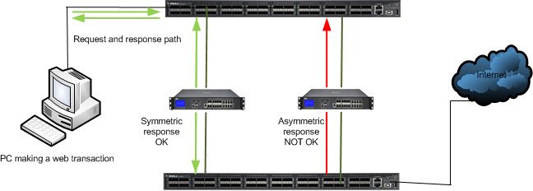
Solution Architecture deep dive (Symmetric Hashing)
What is symmetric Hashing/load balancing, and why is this important?

Slide 14
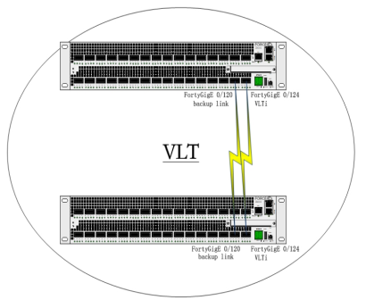
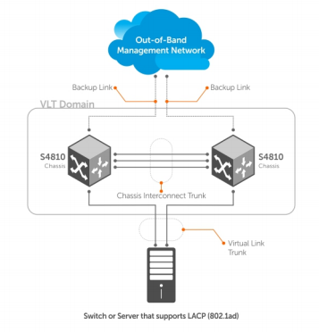
Solution Architecture deep dive (VLT)
What is VLT?
Virtual link trunking (VLT) allows physical links between two chassis to appear as a single virtual link to the network core or other switches such as Edge, Access, or top-of-rack (ToR). VLT reduces the role of spanning tree protocols (STPs) by allowing link aggregation group (LAG) terminations on two separate distribution or core switches, and by supporting a loop-free topology. (To prevent the initial loop that may occur prior to VLT being established, use a spanning tree protocol. After VLT is established, you may use rapid spanning tree protocol (RSTP) to prevent loops from forming with new links that are incorrectly connected and outside the VLT domain.) VLT provides Layer 2 multipathing, creating redundancy through increased bandwidth, enabling multiple parallel paths between nodes and load-balancing traffic where alternative paths exist
Virtual link trunking offers the following benefits:
• Allows a single device to use a LAG across two upstream devices as shown here.
• Eliminates STP-blocked ports.
• Provides a loop-free topology.
• Uses all available uplink bandwidth.
• Provides fast convergence if either the link or a device fails.
• Optimized forwarding with virtual router redundancy protocol (VRRP).
• Provides link-level resiliency.
• Assures high availability

Slide 15
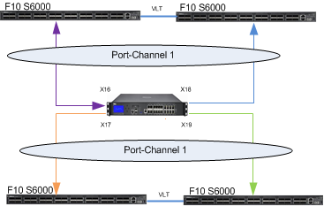
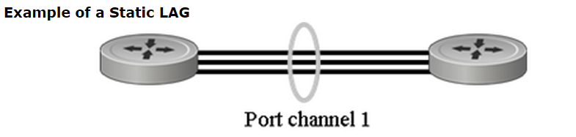
Solution Architecture deep dive (LACP)
Use of Port-Channel (LACP)
A port channel, also referred to as a Link Aggregation Group (LAG), per IEEE 802.3ad, is a mechanism for combining the bandwidth of multiple physical ports in a switch into one logical link. Treat a port channel as if it were an individual port. LACP packets are exchanged end-to-end, thus if a link in the group were to fail, LACP will time out and remove the port from the LAG. The default LACP settings, with the short timers, will remove the port from the LAG in less than a seconds.

Slide 16
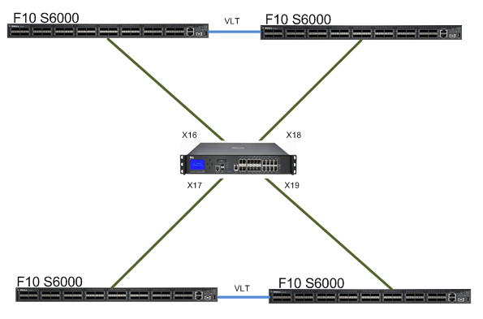
Solution Architecture deep dive (Meshing)
What is Active Active Mesh?
Traffic intended for the failed switch is either passed onto the other VLT switch or load balanced across the two switches via Port-Channel load balancing. This is only possible when the Switches utilize a combination of VLT and Port-Channels. The Firewall in between is connected to all the 4 switches and will be taking load across all 4 links.

Slide 17
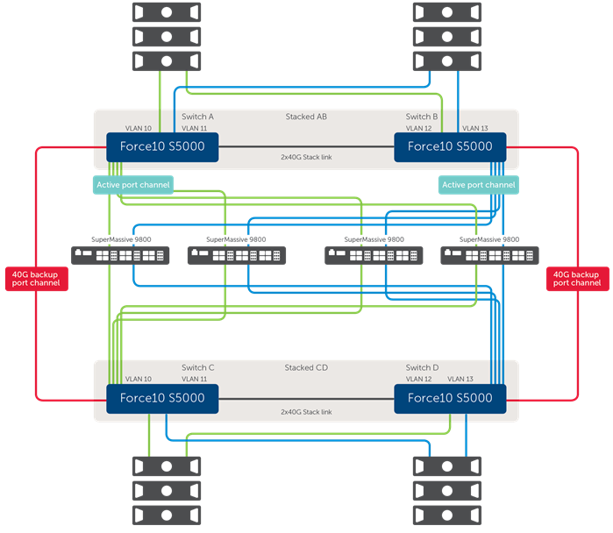
Firewall sandwich architecture
Blueprint for deploying a network-based scale-out security layer architecture
Highly resilient Layer 2 design offering transparent security services to enhance existing security solutions, separate security functions or provide added capacity”
Fully validate with Dell Networking S4810, S5000, S6000 and Dell Network Security SuperMassive 9x00 series NGFW products
Provide N+1 redundancy (vs. 1+1) without reliance on HA or clustering protocols
Support 1, 10 or 40GE ingress/egress connections (today) and performance
Technologies utilized: VLT, Symmetric Hashing, Port Channel LAG, Active Mesh

Slide 18
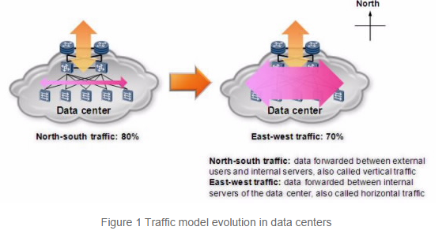
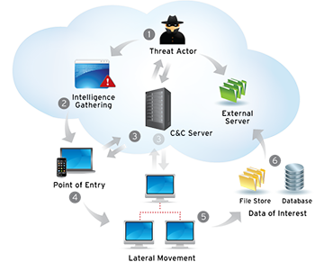
Why such a design
Networking reasons
  Scalability, commoditization of 10/40 GbE
  Convergence of layers
  Redundancy and resiliency
  Increases in east to west traffic
    Virtualization, Datacenters
Security reasons
  Scalability, commoditization of 10/40 GbE
  Inspection at the Distribution/Core layer not just Access
  East to West inspection
  Malware Lifecycle (lateral movements, exfiltration, reconnaissance)

Slide 19




Firewall sandwich deployment options for all customer scenarios : The Classic Firewall Sandwich
Customer currently owns and opts to keep their existing firewall infrastructure
  Usually a Cisco or Juniper solution deployed at the perimeter for Stateful Packet Inspection, Routing, and NAT
  Would like to add Deep Packet Inspection : Cisco and Juniper are unable to provide this at an effective price point
  Non-intrusive deployment, highly resilient design
Routing/Stateful
Perimeter
Deep Packet
Inspection
Distribution

Slide 20
FWS Configuration
S5000 ingress/egress switch layer
  Configure stacking/VLT for switch pairs
    Use 40GE interfaces for stack backplane
  Configure primary port-channel using LACP
    Add 10GE interfaces for firewall connections
    Set as switchport (Layer 2)
    Define backup port-channel and min links
  Configure backup port-channel using LACP
    Use 40GE interfaces for bypass LAG
    Set as switchport (Layer 2)
  Configure ingress/egress interfaces
    Add VLANs as required and assign to port-channels
    Set as switchport (Bridging) or Trunk (VLANs)
  Configure Load-balancing
    Set hashing algorithm and seed value
    Set load-balancing method
SuperMassive 9x00 security layer
  Configure WAN interface for management and register/license
    Set DNS, NTP, update signatures, etc
  Configure ingress/egress Wire Mode pair
    Configure zones
    Configure Secure Wire Mode
    Disable Stateful Inspection
  Configure security services
    App Control, CFS, IPS, GAV, Anti-Spyware, Geo-IP, Botnet Filter and DPI-SSL are supported
  Enable security services for zone(s)
    Configure desired firewall policies
  Configure management and reporting
    Syslog, IPFIX Extended (Splunk)

Slide 21
Deploying Dell-SonicWALL’s Scaled-Out Security Architecture
Bypass
Inspect
Secure
Effect to Network traffic
Deployment time

Slide 22
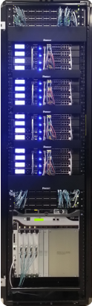
NGFW x 16 Cluster
120 Gbps of DPI & Security processing
700+ GHz of compute
40 Million TCP sessions
4X cost effective and scales higher vs. traditional solutions
Provides N+1 redundancy without complex HA or clustering protocols
Single management console for cluster
Supports 1, 10 or 40GbE ingress/egress connections

Slide 23

Firewall sandwich deployment options for all customer scenarios : The Double Firewall Sandwich
Customer would like to completely replace their existing firewall infrastructure and go all Dell!
  Requires Routing and Deep Packet Inspection solutions
  While maintaining high performance and superb resiliency
  Dell-SonicWALL NGFW High Availability Pair, at the perimeter providing Layer 3 services
  Classic Firewall Sandwich, providing all Deep Packet Inspection Services
Routing/Stateful
Perimeter
Deep Packet
Inspection
Distribution

Slide 24
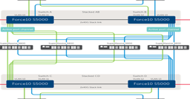






Firewall sandwich deployment options for all customer scenarios : The Open Firewall Sandwich
  Customer would like to replace their firewall solution with Dell-SonicWALL’s but would prefer to leverage their existing switch infrastructure
  Requires enormous amount of NAT and concurrent connections
  3rd party Layer 3 Network Loadbalancer needed
Internet
Routing/Stateful
or
Deep Packet Inspection
Link Aggregation
Perimeter
Distribution
L3 Load balancer
Loadbalancer
Loadbalancer

Slide 25



Transform NGFW economics and Data Center agility
Dell can deliver cost savings up to 85%* lower than Cisco, 57% lower than Palo Alto Networks and up to 53%* lower than Fortinet
Competitor Deployment
Dell FireWALL Sandwich
Switch layer - ingress
Dell Networking S5000
10GbE
10GbE
1+1 Active/Passive
Firewall layer
N+1 Active
Firewall layer
SuperMassive 9800
Switch layer - egress
Dell Networking S5000
100%
1/2*
40%*
3X*
2X*
2X*
Infrastructure utilization
The price of the Cisco ASA CX SSP-60
Better price per Protected Mbps than the Palo Alto Networks
5060
Higher IPS throughput than the Check Point
Higher IPS throughput than the Fortinet
Better scalability (connections/s) than Palo Alto Networks
* All pricing and performance figures taken from published information for comparable model or configurations.

Slide 26
How far can I go?
Cluster of Firewall Blades configuration (Wiremode. NATed, Routed)
Firewall Mode | Security Services | Platform | Dell F10 Switches | Throughput | DPI-SSL Throughput | TCP connection per seconds | Max Concurrent connections
Wiremode | IPS+ App Intelligence | SM9400 (16 units) | S5000, S6000 | 160G (120G recommended for redundancy) | 40G | 2.2 Million | 24 Million
 | IPS+ App Intelligence | SM9800 (16 units) | S5000, S6000 | 320G (240G recommended for redundancy) | 80G | 4.5 Million | 40 Million
 | IPS, GAV, ASPY and Application Intelligence | SM9800 (16 units) | S5000, S6000 | 160G (120G recommended for redundancy) | 80G | 4.5 Million | 40 Million
NATed/Routed | IPS, GAV, ASPY and Application Intelligence | SM9400 (16 units) + 4 X SM9800 | S5000, S6000 | 120G | 40G | 1.1 Million | 12 Million
 | IPS, GAV, ASPY and Application Intelligence | SM9800 (16 units) + 4 X SM10800 | S5000, S6000 | 120G | 80G | 1.6 Million | 40 Million

Slide 27
Thank you!

